Slide 1
Mathematical Induction: Introduction and basic problems
CMSC 250

Slide 2
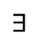
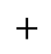
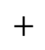
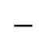
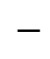
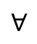
Jason’s Tree of proof methods™
Statement S
$$∀$$
$$∃$$
Universal Statement
Existential Statement
$$+$$
$$−$$
$$+$$
$$−$$
Universal Proof
Existential Proof
Direct
Indirect
Constructive
Non- Constructive
Exhaustion
Cases
Definitions
…
Contradiction
Contraposition

Slide 3
Jason’s Tree of proof methods™
Statement S
$$∀$$
$$∃$$
Universal Statement
Existential Statement
$$+$$
$$−$$
$$+$$
$$−$$
Universal Proof
Existential Proof
Direct
Indirect
Constructive
Non- Constructive
Exhaustion
Cases
Definitions
…
Contradiction
Contraposition

Slide 4
Jason’s Tree of proof methods™
Statement S
$$∀$$
$$∃$$
Universal Statement
Existential Statement
$$+$$
$$−$$
$$+$$
$$−$$
Universal Proof
Existential Proof
Direct
Indirect
Constructive
Non- Constructive
Exhaustion
Cases
Definitions
…
Contradiction
Contraposition
Induction
Weak (Classical)
Strong
Structural
Constructive

Slide 5
Jason’s Tree of proof methods™
Statement S
$$∀$$
$$∃$$
Universal Statement
Existential Statement
$$+$$
$$−$$
$$+$$
$$−$$
Universal Proof
Existential Proof
Direct
Indirect
Constructive
Non- Constructive
Exhaustion
Cases
Definitions
…
Contradiction
Contraposition
Induction
Weak (Classical)
Strong
Structural
Constructive
Iffy

Slide 6
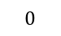
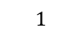



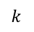
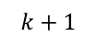
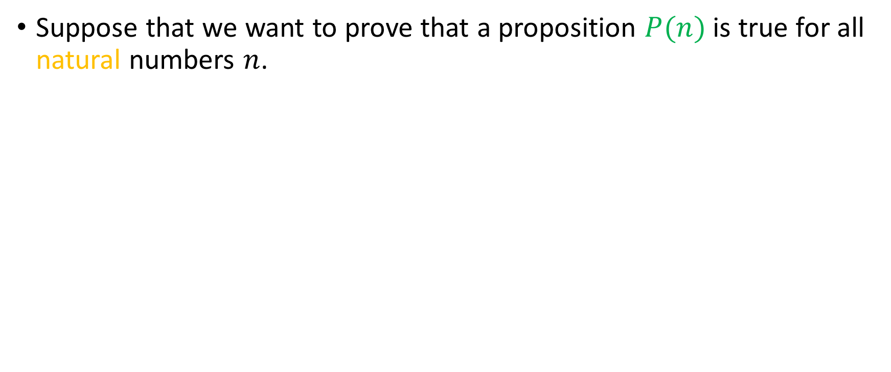
The idea behind induction
Suppose that we want to prove that a proposition $P(n)$ is true for all natural numbers $n$.
$$0$$
$$1$$
$$2$$
$$…$$
$$…$$
$$k$$
$$k+1$$
$$…$$
$$…$$
$$…$$

Slide 7
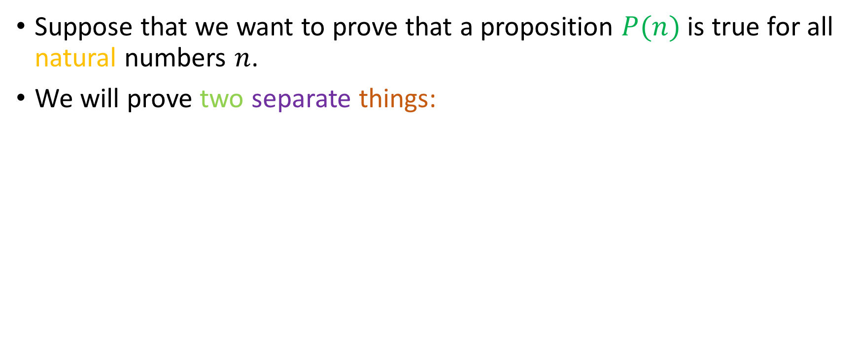
The idea behind induction
Suppose that we want to prove that a proposition $P(n)$ is true for all natural numbers $n$.
We will prove two separate things:
$$0$$
$$1$$
$$2$$
$$…$$
$$…$$
$$k$$
$$k+1$$
$$…$$
$$…$$
$$…$$

Slide 8

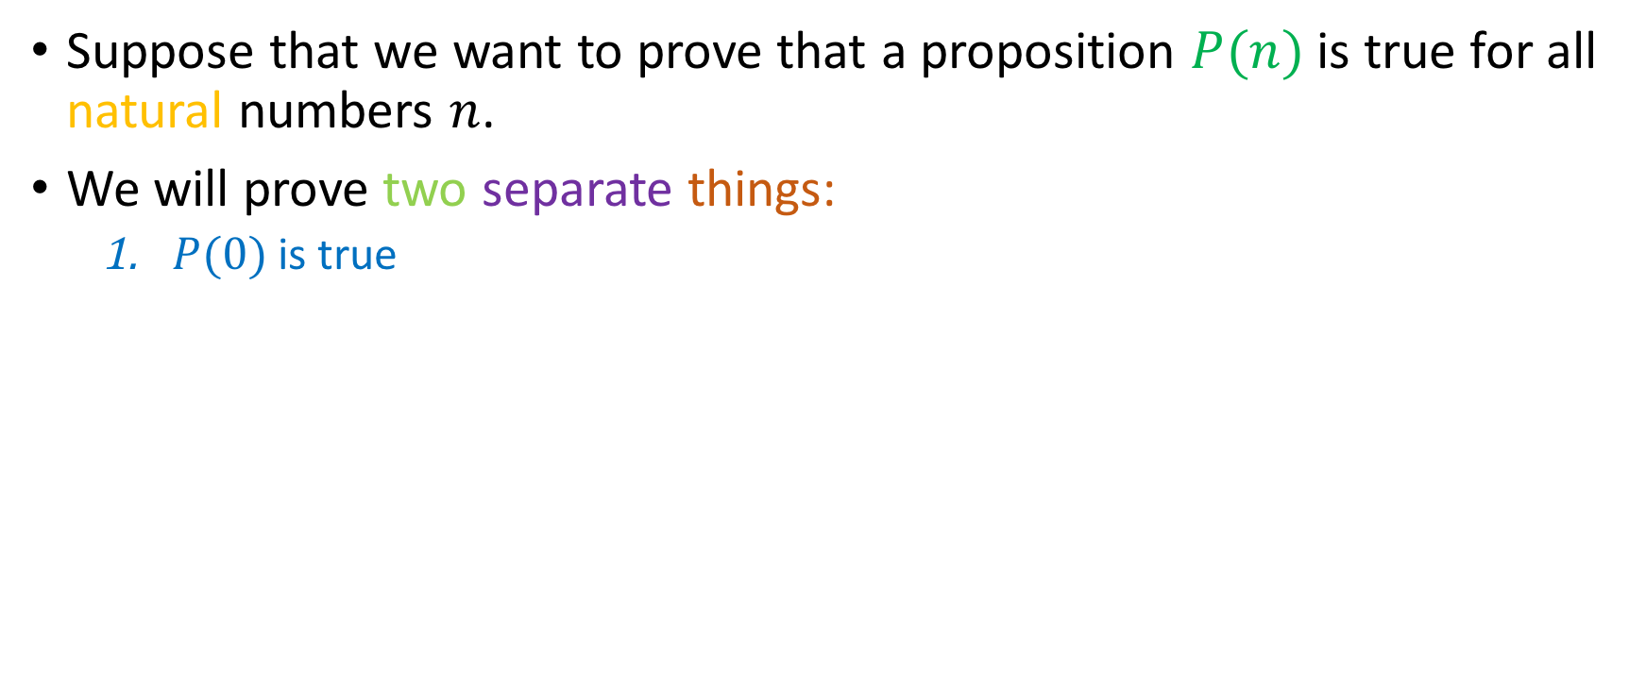
The idea behind induction
Suppose that we want to prove that a proposition $P(n)$ is true for all natural numbers $n$.
We will prove two separate things:
$P(0)$ is true
$$0$$
$$1$$
$$2$$
$$…$$
$$…$$
$$k$$
$$k+1$$
$$…$$
$$…$$
$$…$$

Slide 9

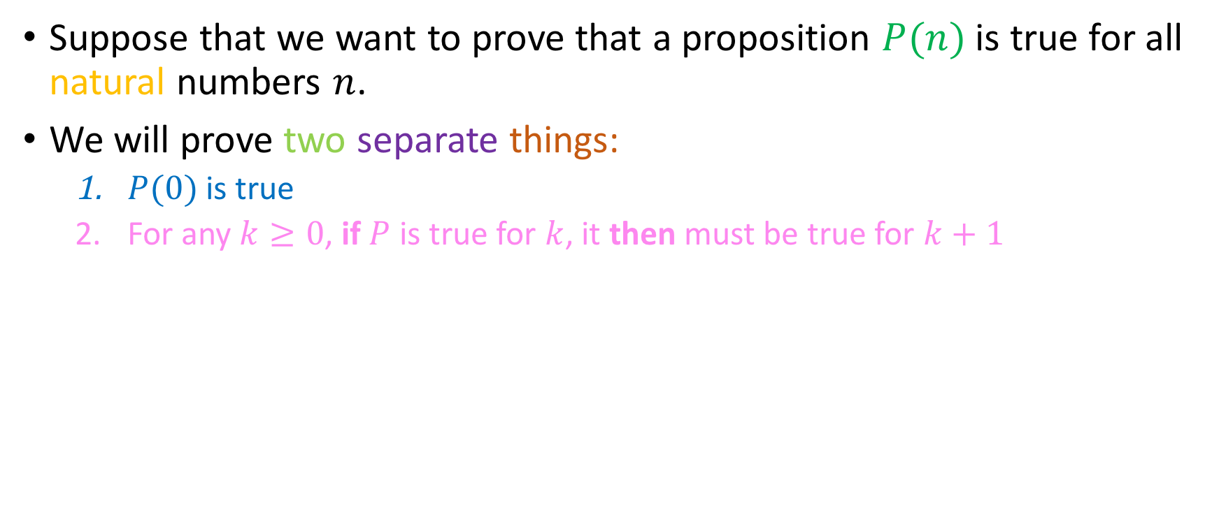
The idea behind induction
Suppose that we want to prove that a proposition $P(n)$ is true for all natural numbers $n$.
We will prove two separate things:
$P(0)$ is true
For any $k≥0$, if $P$ is true for $k$, it then must be true for $k+1$
$$0$$
$$1$$
$$2$$
$$…$$
$$…$$
$$k$$
$$⇒$$
$$k+1$$
$$…$$
$$…$$
$$…$$

Slide 10
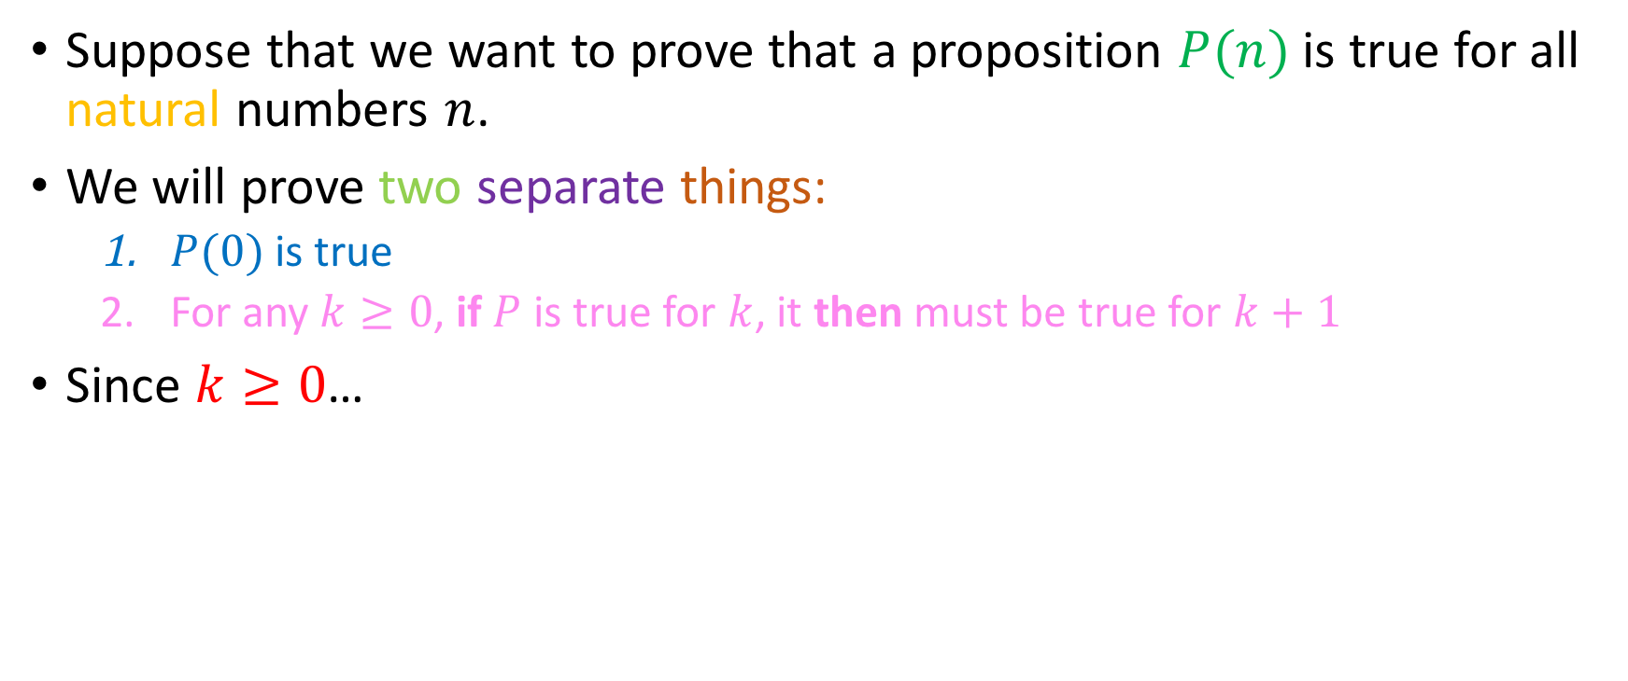
The idea behind induction
Suppose that we want to prove that a proposition $P(n)$ is true for all natural numbers $n$.
We will prove two separate things:
$P(0)$ is true
For any $k≥0$, if $P$ is true for $k$, it then must be true for $k+1$
Since $k≥0$…
$$0$$
$$1$$
$$2$$
$$…$$
$$…$$
$$k$$
$$⇒$$
$$k+1$$
$$…$$
$$…$$
$$…$$

Slide 11

The idea behind induction
Suppose that we want to prove that a proposition $P(n)$ is true for all natural numbers $n$.
We will prove two separate things:
$P(0)$ is true
For any $k≥0$, if $P$ is true for $k$, it then must be true for $k+1$
Since $k≥0$…
$$0$$
$$1$$
$$2$$
$$…$$
$$…$$
$$k$$
$$⇒$$
$$k+1$$
$$…$$
$$…$$
$$…$$

Slide 12
The idea behind induction
Suppose that we want to prove that a proposition $P(n)$ is true for all natural numbers $n$.
We will prove two separate things:
$P(0)$ is true
For any $k≥0$, if $P$ is true for $k$, it then must be true for $k+1$
Since $k≥0$…
$$0$$
$$1$$
$$2$$
$$…$$
$$…$$
$$k$$
$$⇒$$
$$k+1$$
$$…$$
$$…$$
$$…$$

Slide 13

The idea behind induction
Suppose that we want to prove that a proposition $P(n)$ is true for all natural numbers $n$.
We will prove two separate things:
$P(0)$ is true
For any $k≥0$, if $P$ is true for $k$, it then must be true for $k+1$
Since $k≥0$…
$$0$$
$$1$$
$$2$$
$$…$$
$$…$$
$$k$$
$$⇒$$
$$k+1$$
$$…$$
$$…$$
$$…$$

Slide 14
The idea behind induction
Suppose that we want to prove that a proposition $P(n)$ is true for all natural numbers $n$.
We will prove two separate things:
$P(0)$ is true
For any $k≥0$, if $P$ is true for $k$, it then must be true for $k+1$
Since $k≥0$…
$$0$$
$$1$$
$$2$$
$$…$$
$$…$$
$$k$$
$$⇒$$
$$k+1$$
$$…$$
$$…$$
$$…$$

Slide 15

The idea behind induction
Suppose that we want to prove that a proposition $P(n)$ is true for all natural numbers $n$.
We will prove two separate things:
$P(0)$ is true
For any $k≥0$, if $P$ is true for $k$, it then must be true for $k+1$
Since $k≥0$…
$$0$$
$$1$$
$$2$$
$$…$$
$$…$$
$$k$$
$$⇒$$
$$k+1$$
$$…$$
$$…$$
$$…$$

Slide 16
The idea behind induction
Suppose that we want to prove that a proposition $P(n)$ is true for all natural numbers $n$.
We will prove two separate things:
$P(0)$ is true
For any $k≥0$, if $P$ is true for $k$, it then must be true for $k+1$
Since $k≥0$…
$$0$$
$$1$$
$$2$$
$$…$$
$$…$$
$$k$$
$$⇒$$
$$k+1$$
$$…$$
$$…$$
$$…$$

Slide 17

The idea behind induction
Suppose that we want to prove that a proposition $P(n)$ is true for all natural numbers $n$.
We will prove two separate things:
$P(0)$ is true
For any $k≥0$, if $P$ is true for $k$, it then must be true for $k+1$
Since $k≥0$…
$$0$$
$$1$$
$$2$$
$$…$$
$$…$$
$$k$$
$$⇒$$
$$k+1$$
$$…$$
$$…$$
$$…$$

Slide 18
The idea behind induction
Suppose that we want to prove that a proposition $P(n)$ is true for all natural numbers $n$.
We will prove two separate things:
$P(0)$ is true
For any $k≥0$, if $P$ is true for $k$, it then must be true for $k+1$
Since $k≥0$…
$$0$$
$$1$$
$$2$$
$$…$$
$$…$$
$$k$$
$$⇒$$
$$k+1$$
$$…$$
$$…$$
$$…$$

Slide 19
The idea behind induction
Suppose that we want to prove that a proposition $P(n)$ is true for all natural numbers $n$.
We will prove two separate things:
$P(0)$ is true
For any $k≥0$, if $P$ is true for $k$, it then must be true for $k+1$
Since $k≥0$…
$$0$$
$$1$$
$$2$$
$$…$$
$$…$$
$$k$$
$$⇒$$
$$k+1$$
$$…$$
$$…$$
$$…$$

Slide 20

The idea behind induction
Suppose that we want to prove that a proposition $P(n)$ is true for all natural numbers $n$.
We will prove two separate things:
$P(0)$ is true
For any $k≥0$, if $P$ is true for $k$, it then must be true for $k+1$
Since $k≥0$…
$$0$$
$$1$$
$$2$$
$$…$$
$$…$$
$$k$$
$$⇒$$
$$k+1$$
$$…$$
$$…$$
$$…$$

Slide 21
The idea behind induction
Suppose that we want to prove that a proposition $P(n)$ is true for all natural numbers $n$.
We will prove two separate things:
$P(0)$ is true
For any $k≥0$, if $P$ is true for $k$, it then must be true for $k+1$
Since $k≥0$…
$$0$$
$$1$$
$$2$$
$$…$$
$$…$$
$$k$$
$$⇒$$
$$k+1$$
$$…$$
$$…$$
$$…$$

Slide 22
The idea behind induction
Suppose that we want to prove that a proposition $P(n)$ is true for all natural numbers $n$.
We will prove two separate things:
$P(0)$ is true
For any $k≥0$, if $P$ is true for $k$, it then must be true for $k+1$
Since $k≥0$…
$$0$$
$$1$$
$$2$$
$$…$$
$$…$$
$$k$$
$$⇒$$
$$k+1$$
$$…$$
$$…$$
$$…$$

Slide 23
The idea behind induction
Suppose that we want to prove that a proposition $P(n)$ is true for all natural numbers $n$.
We will prove two separate things:
$P(0)$ is true
For any $k≥0$, if $P$ is true for $k$, it then must be true for $k+1$
Since $k≥0$…
$$0$$
$$1$$
$$2$$
$$…$$
$$…$$
$$k$$
$$⇒$$
$$k+1$$
$$…$$
$$…$$
$$…$$

Slide 24
The idea behind induction
Suppose that we want to prove that a proposition $P(n)$ is true for all natural numbers $n$.
We will prove two separate things:
$P(0)$ is true
For any $k≥0$, if $P$ is true for $k$, it then must be true for $k+1$
Since $k≥0$…
$$0$$
$$1$$
$$2$$
$$…$$
$$…$$
$$k$$
$$⇒$$
$$k+1$$
$$…$$
$$…$$
$$…$$

Slide 25

The idea behind induction
Suppose that we want to prove that a proposition $P(n)$ is true for all natural numbers $n$.
We will prove two separate things:
$P(0)$ is true
For any $k≥0$, if $P$ is true for $k$, it then must be true for $k+1$
Since $k≥0$…
$$0$$
$$1$$
$$2$$
$$…$$
$$…$$
$$k$$
$$⇒$$
$$k+1$$
$$…$$
$$…$$
$$…$$

Slide 26
The idea behind induction
Suppose that we want to prove that a proposition $P(n)$ is true for all natural numbers $n$.
We will prove two separate things:
$P(0)$ is true
For any $k≥0$, if $P$ is true for $k$, it then must be true for $k+1$
Since $k≥0$…
$$0$$
$$1$$
$$2$$
$$…$$
$$…$$
$$k$$
$$⇒$$
$$k+1$$
$$…$$
$$…$$
$$…$$

Slide 27

The idea behind induction
Suppose that we want to prove that a proposition $P(n)$ is true for all natural numbers $n$.
We will prove two separate things:
$P(0)$ is true
For any $k≥0$, if $P$ is true for $k$, it then must be true for $k+1$
Since $k≥0$…
$$0$$
$$1$$
$$2$$
$$…$$
$$…$$
$$k$$
$$⇒$$
$$k+1$$
$$…$$
$$…$$
$$…$$

Slide 28

The idea behind induction
Suppose that we want to prove that a proposition $P(n)$ is true for all natural numbers $n$.
We will prove two separate things:
$P(0)$ is true
For any $k≥0$, if $P$ is true for $k$, it then must be true for $k+1$
Since $k≥0$…
$$0$$
$$1$$
$$2$$
$$…$$
$$…$$
$$k$$
$$⇒$$
$$k+1$$
$$…$$
$$…$$
$$…$$

Slide 29
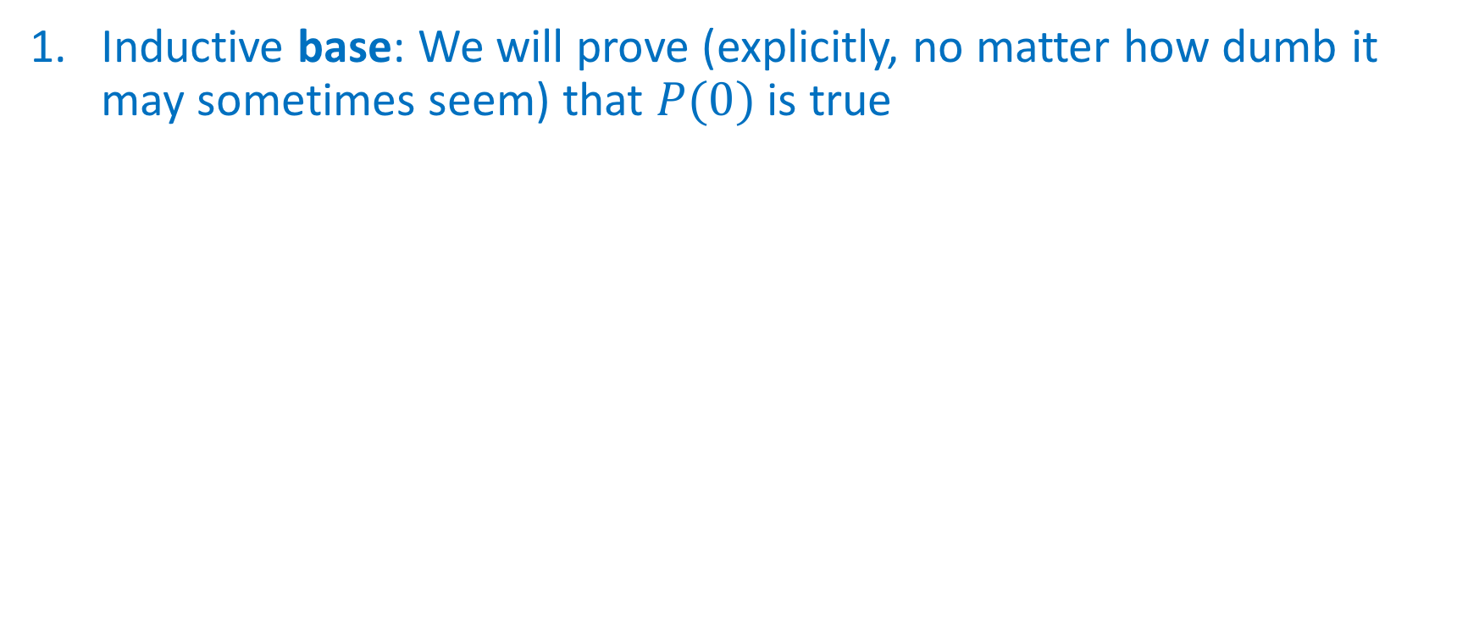
How we’ll make it work
Inductive base: We will prove (explicitly, no matter how dumb it may sometimes seem) that $P(0)$ is true
$$0$$
$$1$$
$$2$$
$$…$$
$$…$$
$$k$$
$$k+1$$
$$…$$
$$…$$
$$…$$

Slide 30

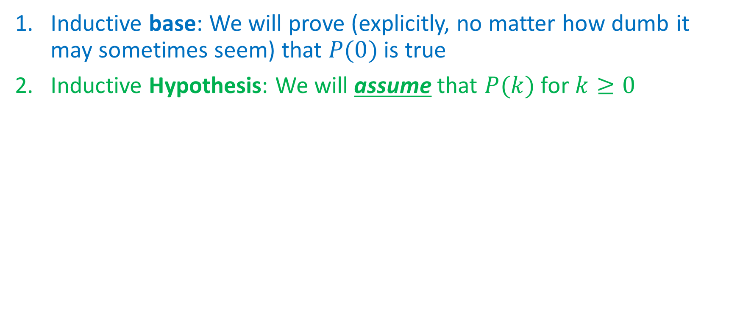
How we’ll make it work
Inductive base: We will prove (explicitly, no matter how dumb it may sometimes seem) that $P(0)$ is true
Inductive Hypothesis: We will assume that $P(k)$ for $k≥0$
Any $k$ at least $0$
$$0$$
$$1$$
$$2$$
$$…$$
$$…$$
$$k$$
$$k+1$$
$$…$$
$$…$$
$$…$$

Slide 31
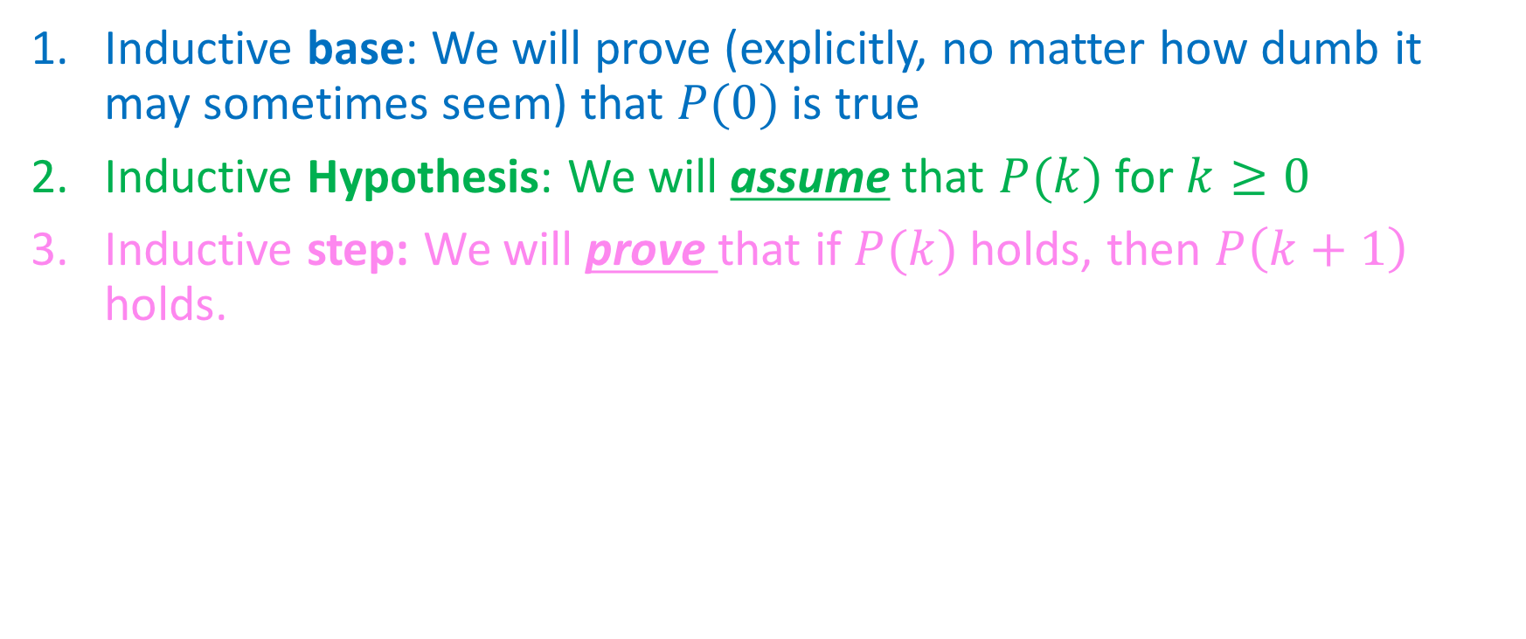
How we’ll make it work
Inductive base: We will prove (explicitly, no matter how dumb it may sometimes seem) that $P(0)$ is true
Inductive Hypothesis: We will assume that $P(k)$ for $k≥0$
Inductive step: We will prove that if $P(k)$ holds, then $P\left(k+1\right)$ holds.
Any $k$ at least $0$
$$0$$
$$1$$
$$2$$
$$…$$
$$…$$
$$k$$
$$k+1$$
$$…$$
$$…$$
$$…$$

Slide 32
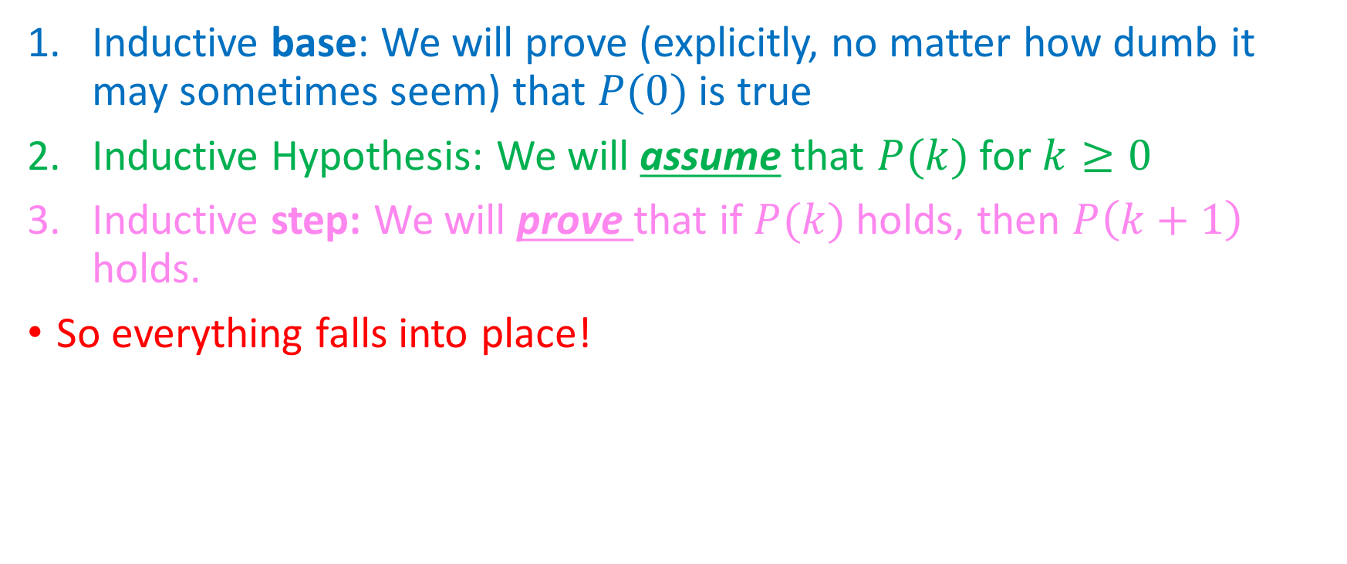
How we’ll make it work
Inductive base: We will prove (explicitly, no matter how dumb it may sometimes seem) that $P(0)$ is true
Inductive Hypothesis: We will assume that $P(k)$ for $k≥0$
Inductive step: We will prove that if $P(k)$ holds, then $P\left(k+1\right)$ holds.
So everything falls into place!
Any $k$ at least $0$
$$0$$
$$1$$
$$2$$
$$…$$
$$…$$
$$k$$
$$k+1$$
$$…$$
$$…$$
$$…$$

Slide 33
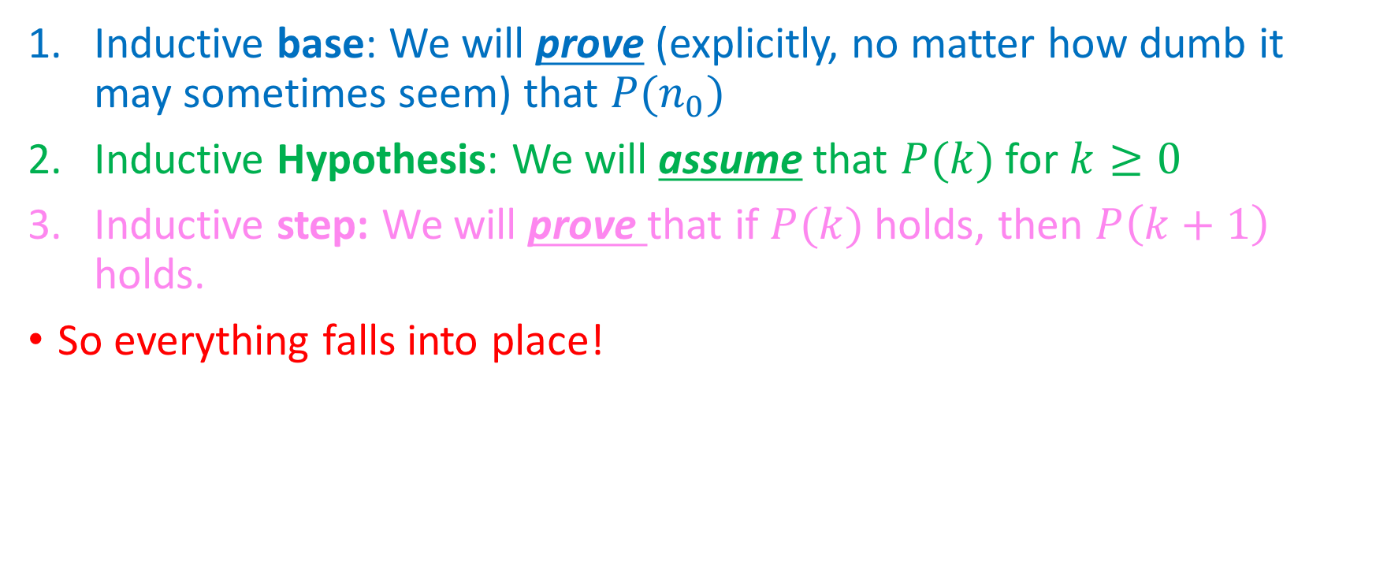
How we’ll make it work
Inductive base: We will prove (explicitly, no matter how dumb it may sometimes seem) that $P(n_{0})$
Inductive Hypothesis: We will assume that $P(k)$ for $k≥0$
Inductive step: We will prove that if $P(k)$ holds, then $P\left(k+1\right)$ holds.
So everything falls into place!
Any $k$ at least $0$
$$0$$
$$1$$
$$2$$
$$…$$
$$…$$
$$k$$
$$k+1$$
$$…$$
$$…$$
$$…$$

Slide 34
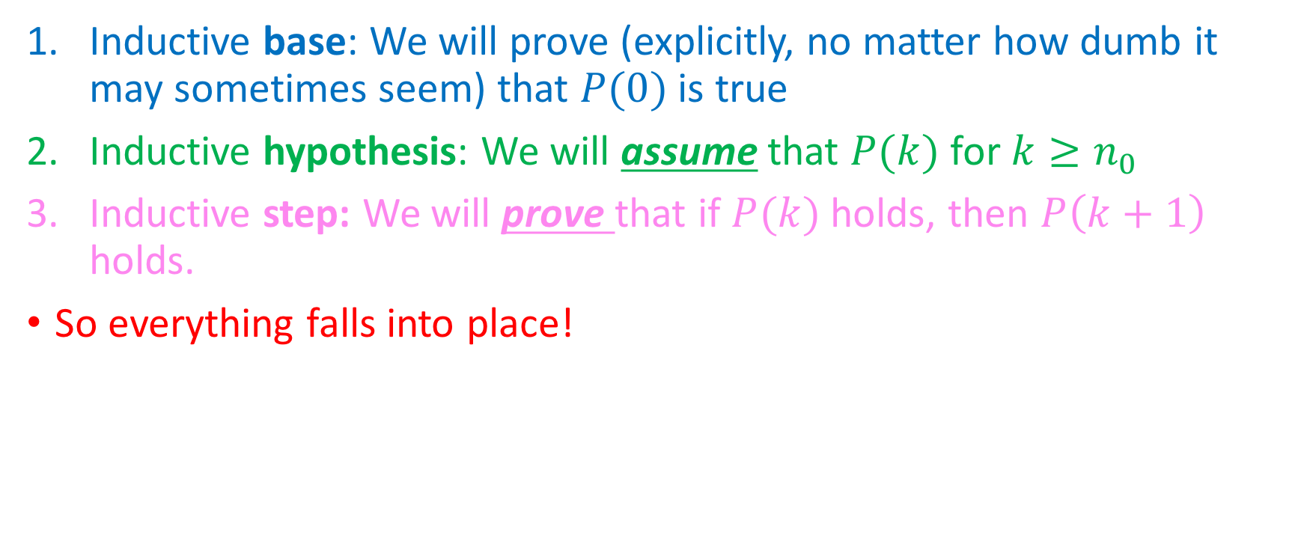
How we’ll make it work
Inductive base: We will prove (explicitly, no matter how dumb it may sometimes seem) that $P(0)$ is true
Inductive hypothesis: We will assume that $P(k)$ for $k≥n_{0}$
Inductive step: We will prove that if $P(k)$ holds, then $P\left(k+1\right)$ holds.
So everything falls into place!
Any $k$ at least $0$
$$0$$
$$1$$
$$2$$
$$…$$
$$…$$
$$k$$
$$k+1$$
$$…$$
$$…$$
$$…$$

Slide 35
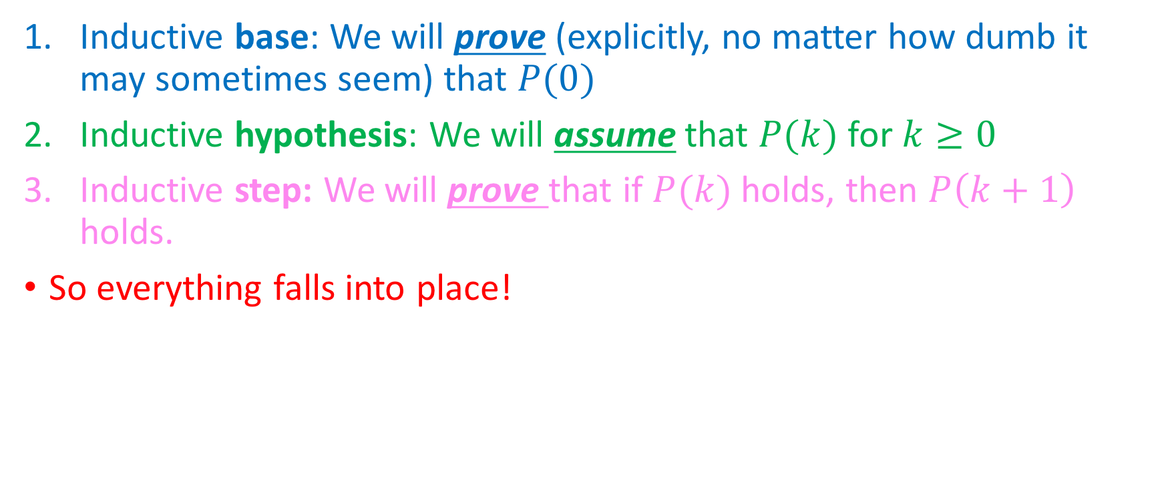
How we’ll make it work
Inductive base: We will prove (explicitly, no matter how dumb it may sometimes seem) that $P(0)$
Inductive hypothesis: We will assume that $P(k)$ for $k≥0$
Inductive step: We will prove that if $P(k)$ holds, then $P\left(k+1\right)$ holds.
So everything falls into place!
Any $k$ at least $0$
$$0$$
$$1$$
$$2$$
$$…$$
$$…$$
$$k$$
$$k+1$$
$$…$$
$$…$$
$$…$$

Slide 36
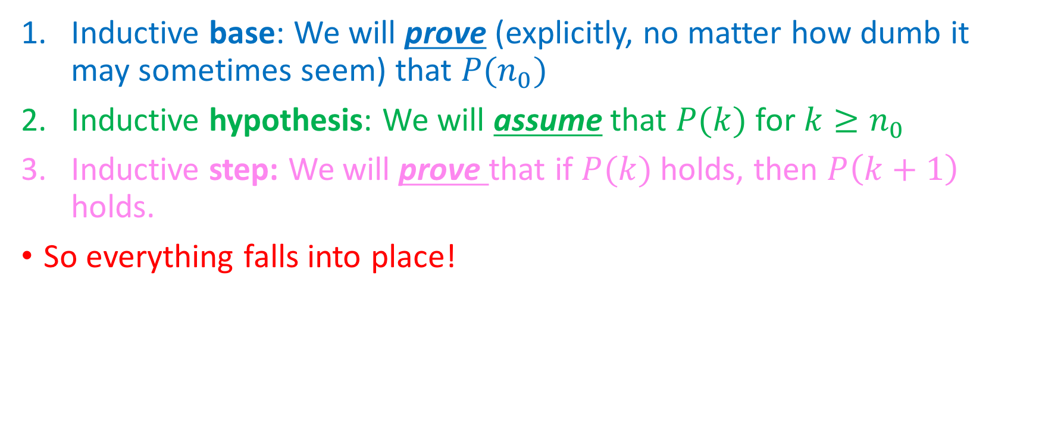
How we’ll make it work
Inductive base: We will prove (explicitly, no matter how dumb it may sometimes seem) that $P(n_{0})$
Inductive hypothesis: We will assume that $P(k)$ for $k≥n_{0}$
Inductive step: We will prove that if $P(k)$ holds, then $P\left(k+1\right)$ holds.
So everything falls into place!
Any $k$ at least $0$
(We fast-forwarded here; time is of the essence!)
$$0$$
$$1$$
$$2$$
$$…$$
$$…$$
$$k$$
$$k+1$$
$$…$$
$$…$$
$$…$$

Slide 37
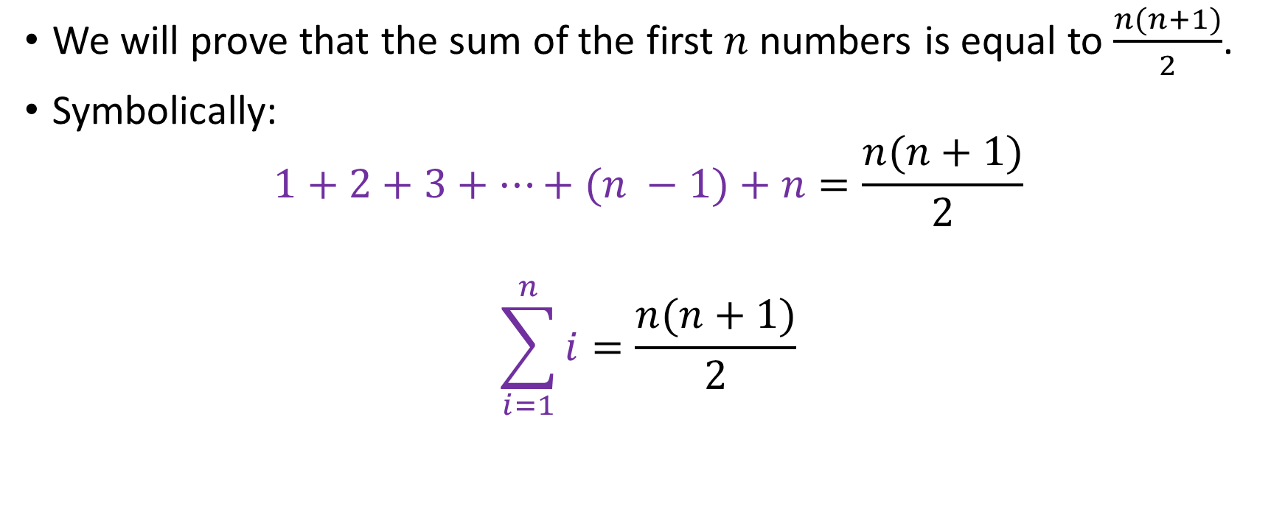
Our first inductive proof
We will prove that the sum of the first $n$ numbers is equal to $\frac{n(n+1)}{2}$.
Symbolically:
$$1+2+3+…+(n −1)+n=\frac{n(n+1)}{2}$$
$$\sum_{i=1}^{n}{i}=\frac{n(n+1)}{2}$$

Slide 38
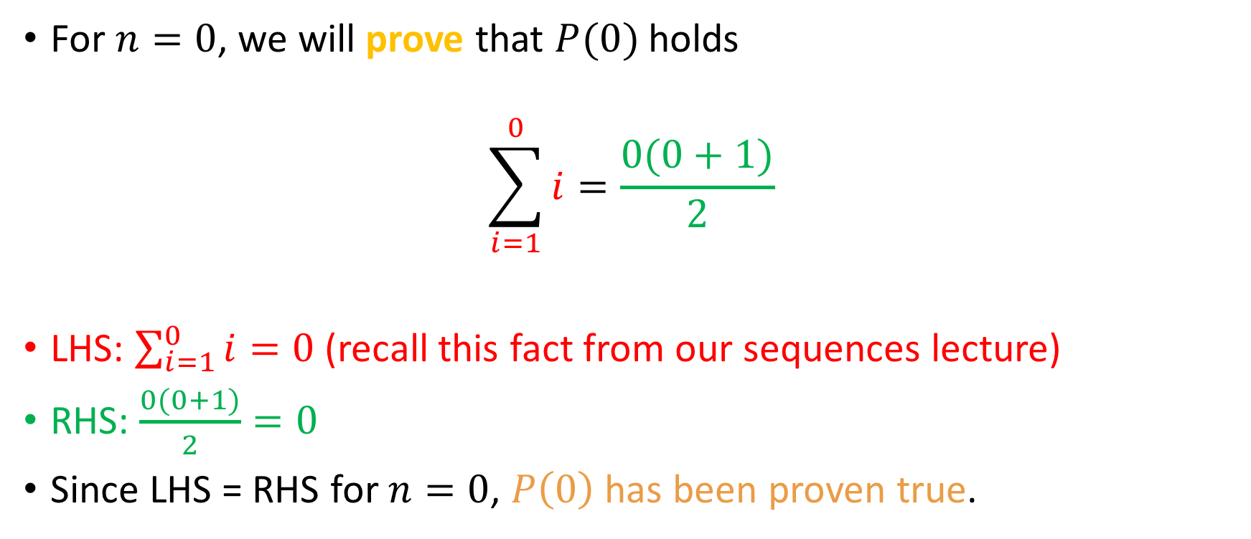
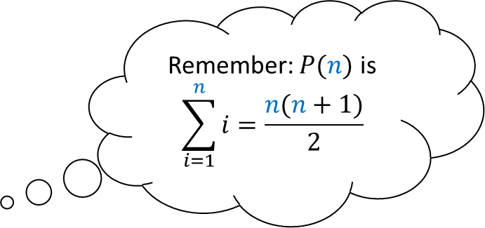
Inductive base
Remember: $P(n)$ is
$$\sum_{i=1}^{n}{i=\frac{n(n+1)}{2}}$$
For $n=0$, we will prove that $P(0)$ holds
$$\sum_{i=1}^{0}{i=\frac{0(0+1)}{2}}$$
LHS: $\sum_{i=1}^{0}{i}=0$ (recall this fact from our sequences lecture)
RHS: $\frac{0(0+1)}{2}=0$
Since LHS = RHS for $n=0$, $P\left(0\right)$has been proven true.
?

Slide 39
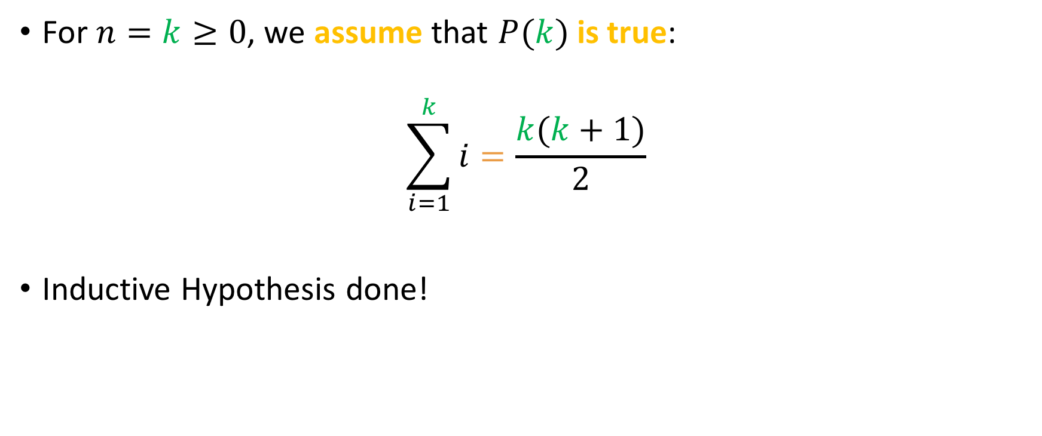
Inductive Hypothesis
Remember: $P(n)$ is
$$\sum_{i=1}^{n}{i=\frac{n(n+1)}{2}}$$
For $n=k≥0$, we assume that $P(k)$is true:
$$\sum_{i=1}^{k}{i}=\frac{k(k+1)}{2}$$
Inductive Hypothesis done!

Slide 40
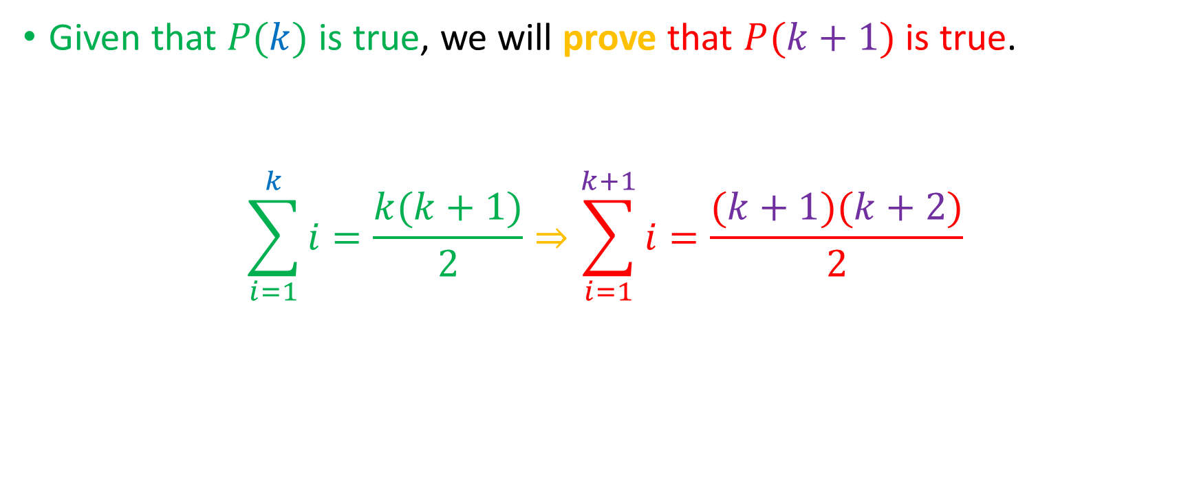
Inductive step
Given that $P(k)$ is true, we will prove that $P(k+1)$ is true.
$$\sum_{i=1}^{k}{i=\frac{k(k+1)}{2}}⇒\sum_{i=1}^{k+1}{i=\frac{(k+1)(k+2)}{2}}$$
This is our goal!

Slide 41


Inductive step
Given that $P(k)$ is true, we will prove that $P(k+1)$ is true.
$$\sum_{i=1}^{k}{i=\frac{k(k+1)}{2}}⇒\sum_{i=1}^{k+1}{i=\frac{(k+1)(k+2)}{2}}$$
Just adding 1 to $k$
Just adding 1 to $k+1$
This is our goal!

Slide 42
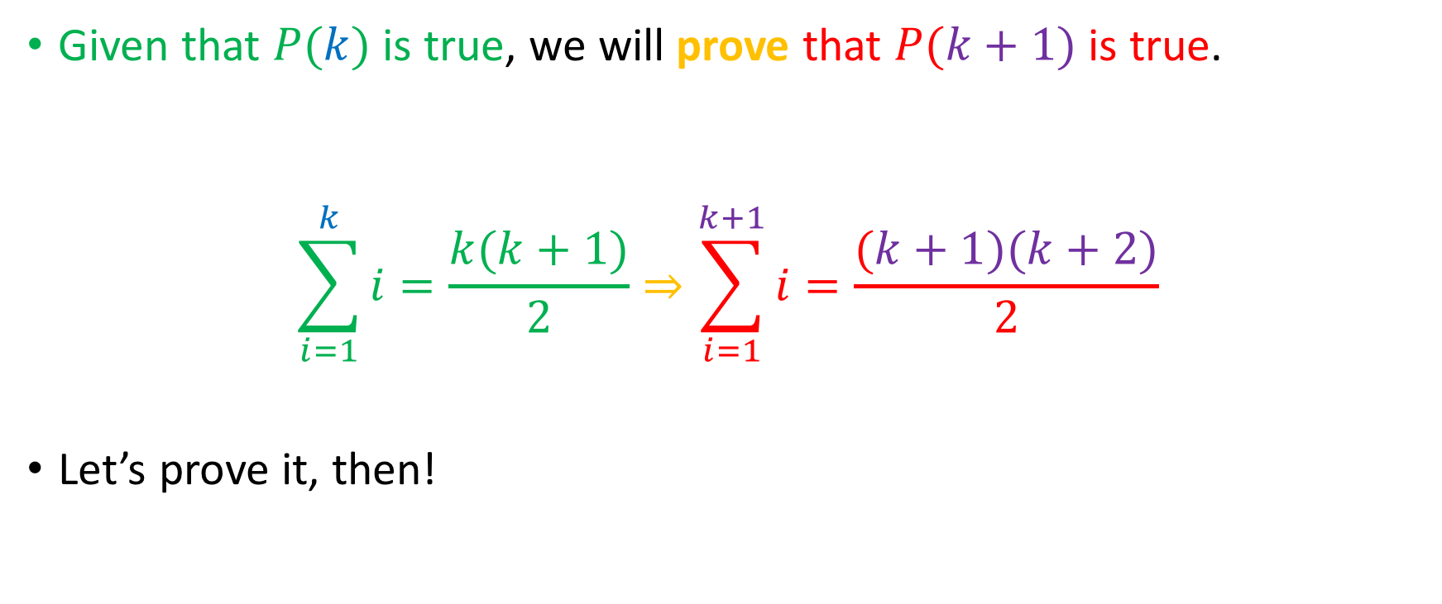
Inductive step
Given that $P(k)$ is true, we will prove that $P(k+1)$ is true.
$$\sum_{i=1}^{k}{i=\frac{k(k+1)}{2}}⇒\sum_{i=1}^{k+1}{i=\frac{(k+1)(k+2)}{2}}$$
Let’s prove it, then!
Just adding 1 to $k$
Just adding 1 to $k+1$
This is our goal!

Slide 43
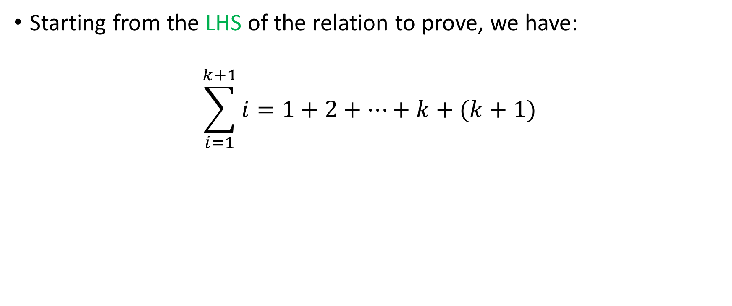
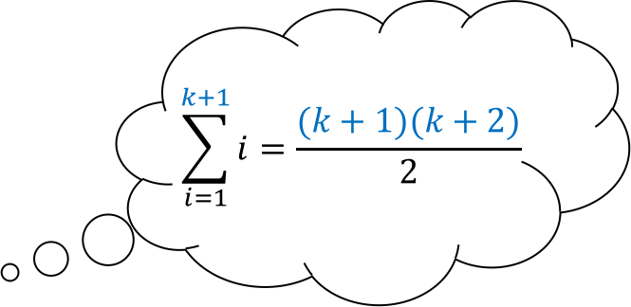
Inductive step, contd.
$$\sum_{i=1}^{k+1}{i=\frac{(k+1)(k+2)}{2}}$$
Starting from the LHS of the relation to prove, we have:
$$\sum_{i=1}^{k+1}{i}=1+2+…+k+(k+1)$$

Slide 44
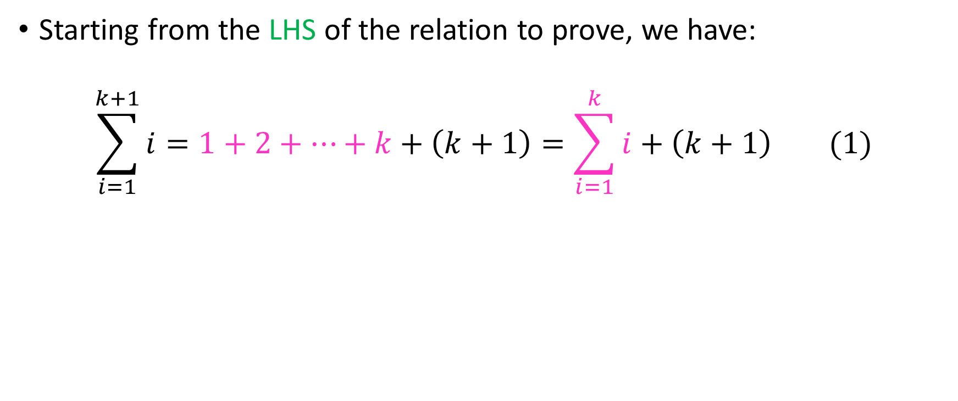
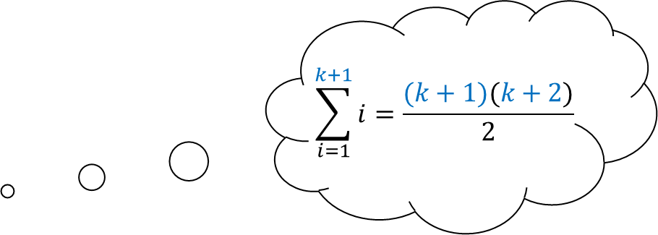
Inductive step, contd.
$$\sum_{i=1}^{k+1}{i=\frac{(k+1)(k+2)}{2}}$$
Starting from the LHS of the relation to prove, we have:
$$\sum_{i=1}^{k+1}{i}=1+2+…+k+\left(k+1\right)=\sum_{i=1}^{k}{i}+\left(k+1\right) (1)$$

Slide 45
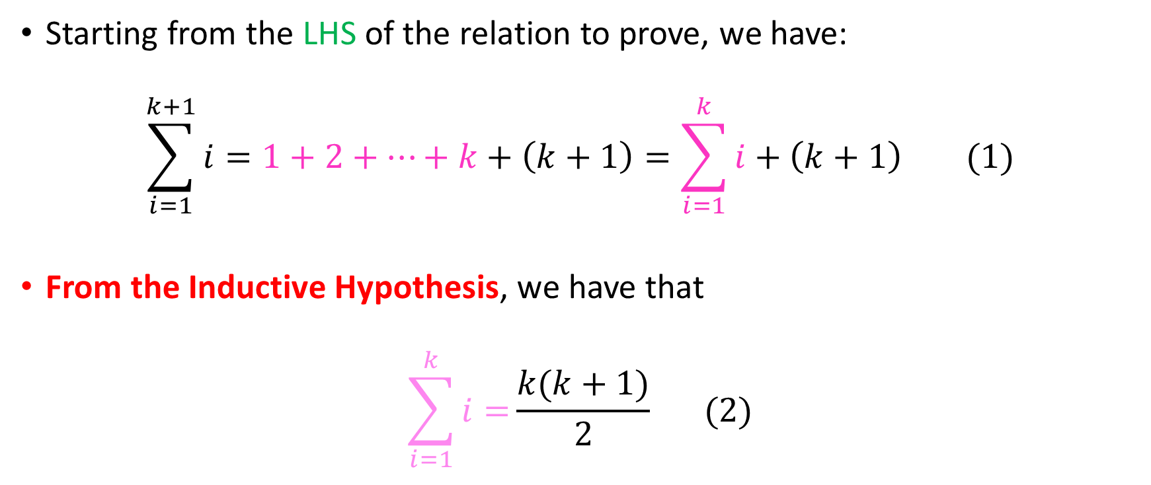
Inductive step, contd.
$$\sum_{i=1}^{k+1}{i=\frac{(k+1)(k+2)}{2}}$$
Starting from the LHS of the relation to prove, we have:
$$\sum_{i=1}^{k+1}{i}=1+2+…+k+\left(k+1\right)=\sum_{i=1}^{k}{i}+\left(k+1\right) (1)$$
From the Inductive Hypothesis, we have that
$$\sum_{i=1}^{k}{i=}\frac{k(k+1)}{2} (2)$$

Slide 46
Inductive step, contd.
$$\sum_{i=1}^{k+1}{i=\frac{(k+1)(k+2)}{2}}$$
Starting from the LHS of the relation to prove, we have:
$$\sum_{i=1}^{k+1}{i}=1+2+…+k+\left(k+1\right)=\sum_{i=1}^{k}{i}+\left(k+1\right) (1)$$
From the Inductive Hypothesis, we have that
$$\sum_{i=1}^{k}{i=}\frac{k(k+1)}{2} (2)$$

Slide 47
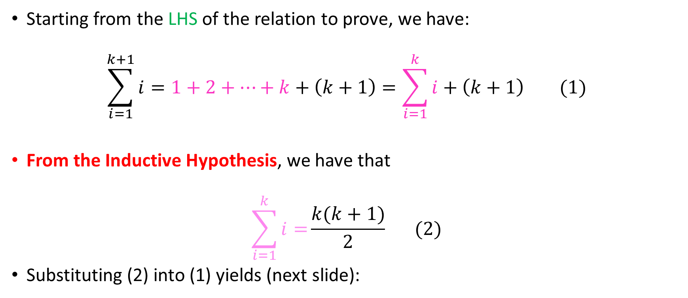
Inductive step, contd.
$$\sum_{i=1}^{k+1}{i=\frac{(k+1)(k+2)}{2}}$$
Starting from the LHS of the relation to prove, we have:
$$\sum_{i=1}^{k+1}{i}=1+2+…+k+\left(k+1\right)=\sum_{i=1}^{k}{i}+\left(k+1\right) (1)$$
From the Inductive Hypothesis, we have that
$$\sum_{i=1}^{k}{i=}\frac{k(k+1)}{2} (2)$$
Substituting (2) into (1) yields (next slide):

Slide 48
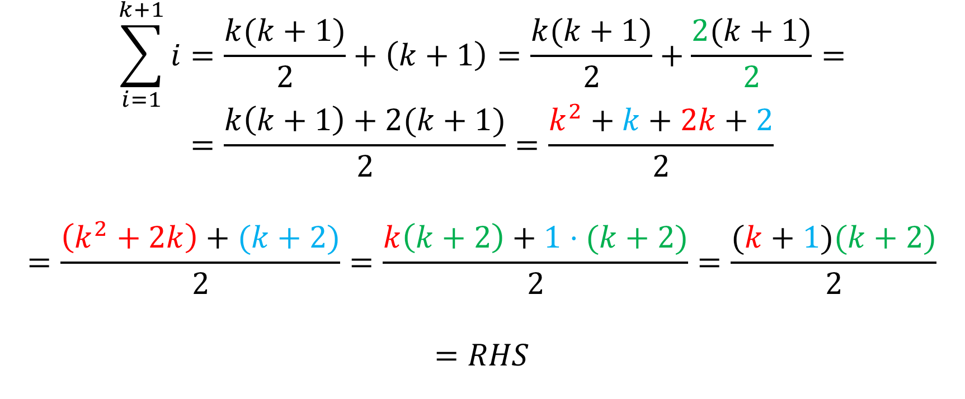
Inductive step, contd.
$$\sum_{i=1}^{k+1}{i}=\frac{k(k+1)}{2}+\left(k+1\right)=\frac{k(k+1)}{2}+\frac{2(k+1)}{2}=$$
$$=\frac{k\left(k+1\right)+2(k+1)}{2}=\frac{k^{2}+k+2k+2}{2}$$
$$=\frac{\left(k^{2}+2k\right)+(k+2)}{2}=\frac{k\left(k+2\right)+1⋅(k+2)}{2}=\frac{(k+1)(k+2)}{2}$$
$$=RHS$$

Slide 49
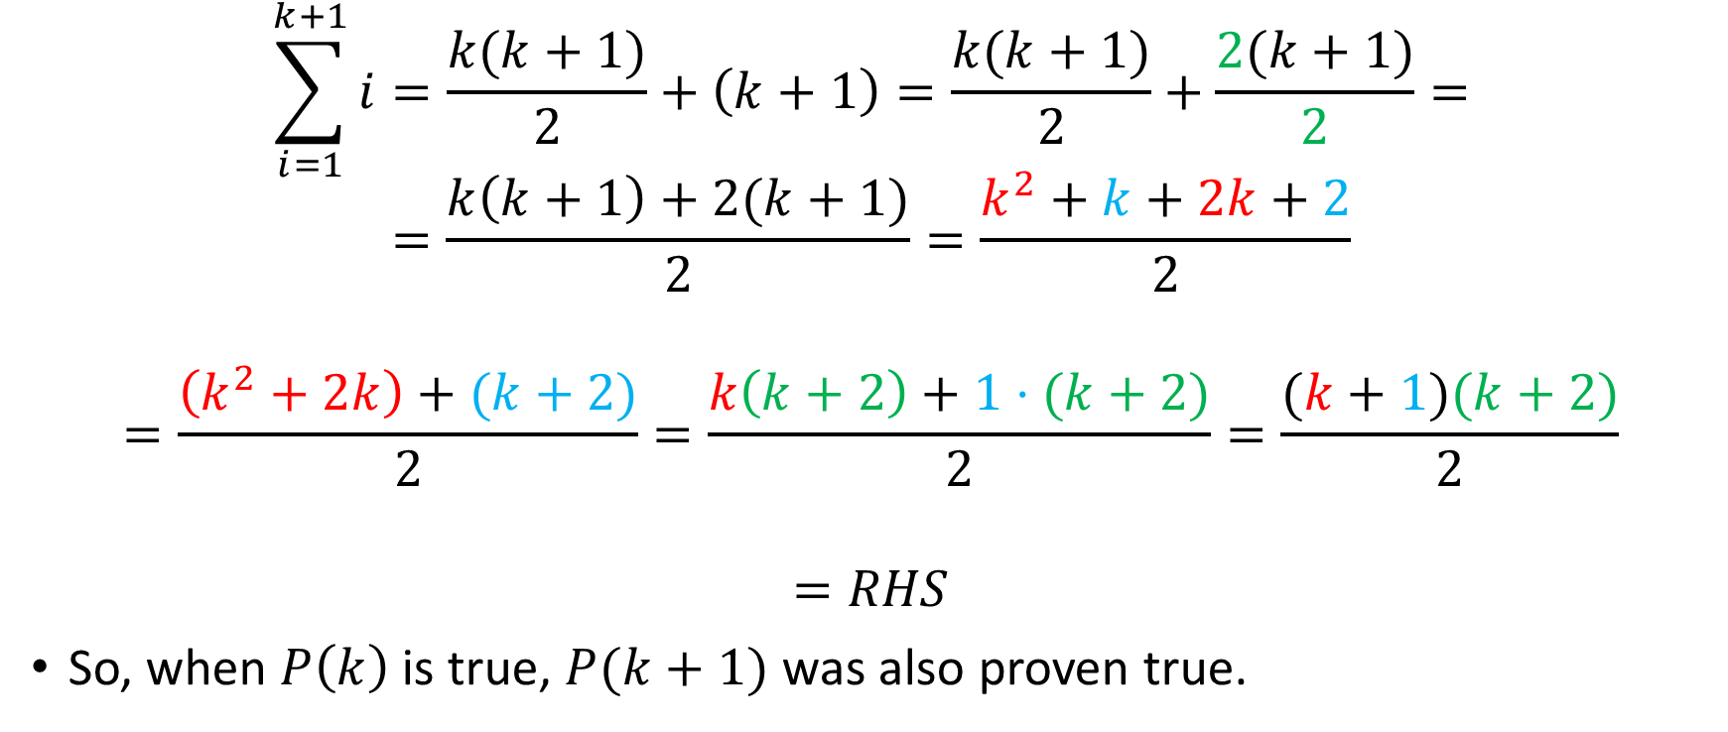
Inductive step, contd.
$$\sum_{i=1}^{k+1}{i}=\frac{k(k+1)}{2}+\left(k+1\right)=\frac{k(k+1)}{2}+\frac{2(k+1)}{2}=$$
$$=\frac{k\left(k+1\right)+2(k+1)}{2}=\frac{k^{2}+k+2k+2}{2}$$
$$=\frac{\left(k^{2}+2k\right)+(k+2)}{2}=\frac{k\left(k+2\right)+1⋅(k+2)}{2}=\frac{(k+1)(k+2)}{2}$$
$$=RHS$$
So, when $P\left(k\right)$ is true, $P(k+1)$ was also proven true.

Slide 50
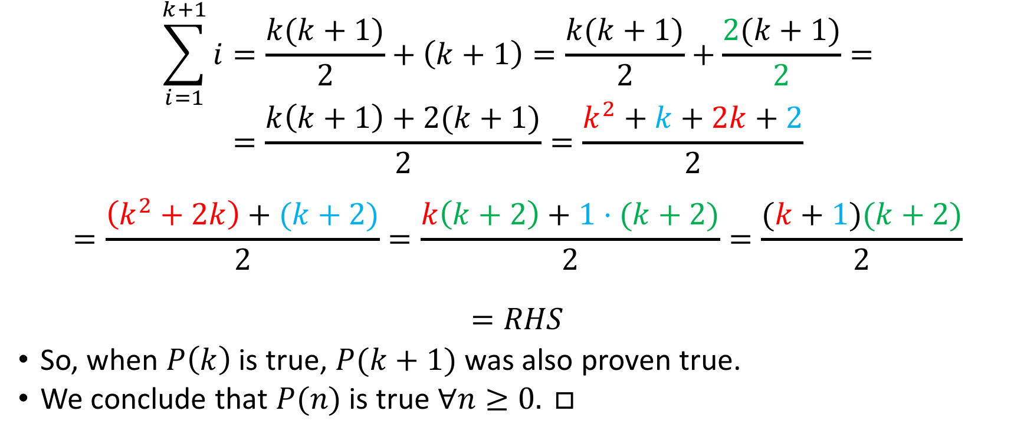
Inductive step, contd.
$$\sum_{i=1}^{k+1}{i}=\frac{k(k+1)}{2}+\left(k+1\right)=\frac{k(k+1)}{2}+\frac{2(k+1)}{2}=$$
$$=\frac{k\left(k+1\right)+2(k+1)}{2}=\frac{k^{2}+k+2k+2}{2}$$
$$=\frac{\left(k^{2}+2k\right)+(k+2)}{2}=\frac{k\left(k+2\right)+1⋅(k+2)}{2}=\frac{(k+1)(k+2)}{2}$$
$$=RHS$$
So, when $P\left(k\right)$ is true, $P(k+1)$ was also proven true.
We conclude that $P(n)$ is true $∀n≥0. □$

Slide 51
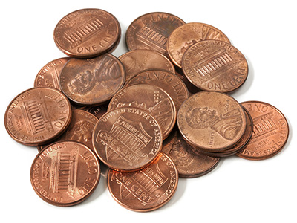
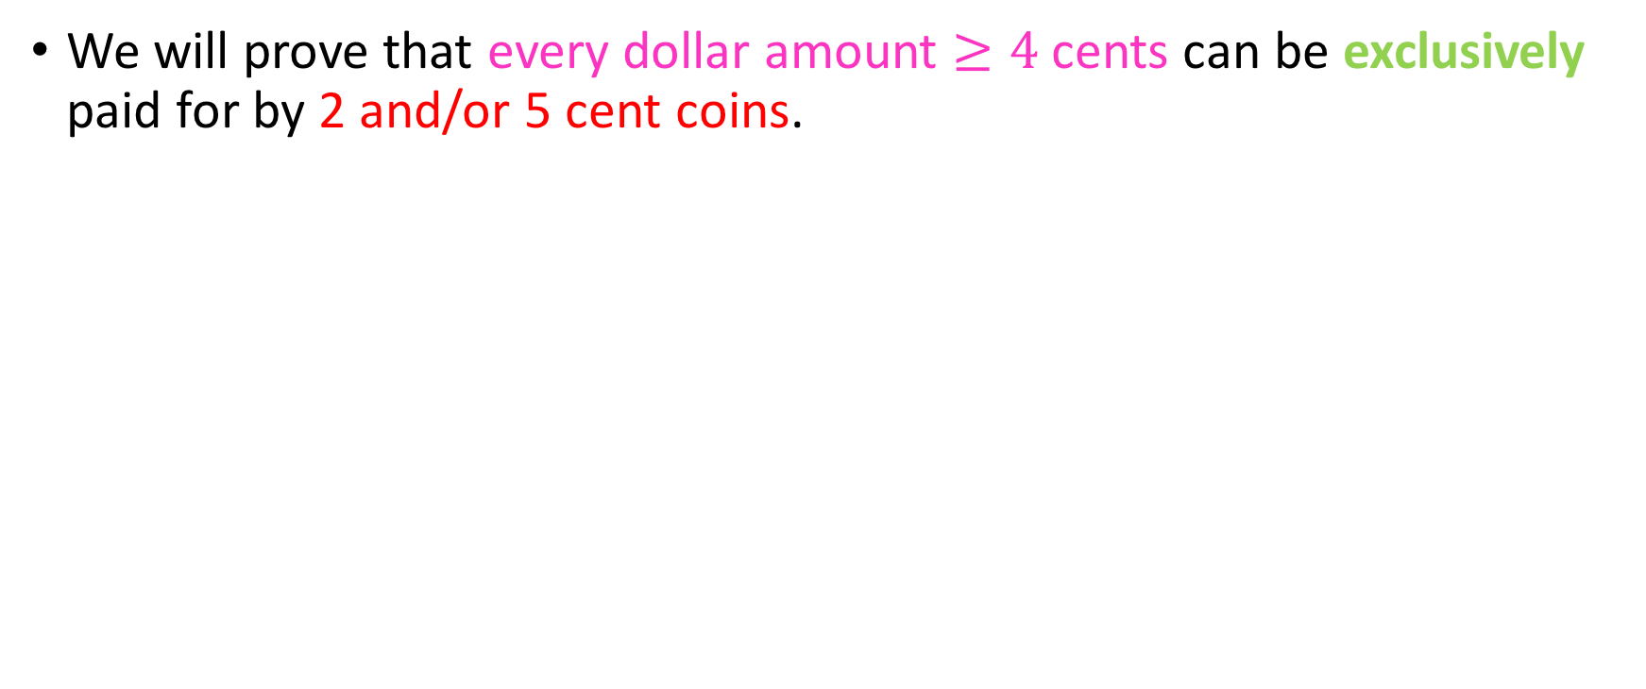
Here’s another
We will prove that every dollar amount $≥4$ cents can be exclusively paid for by 2 and/or 5 cent coins.

Slide 52
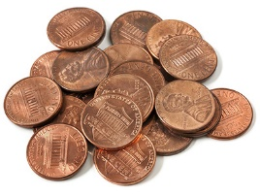
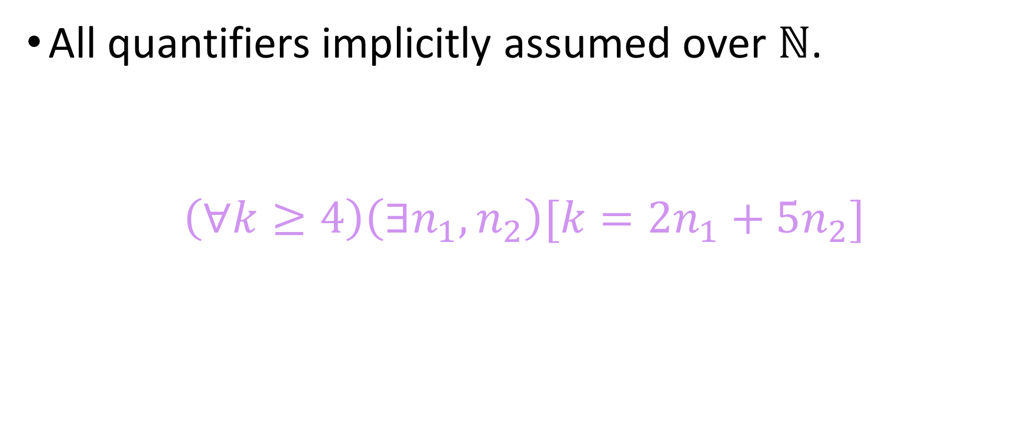
Theorem expressed in quantifiers
All quantifiers implicitly assumed over $ℕ$.
$$\left(∀k≥4\right)\left(∃n_{1},n_{2}\right)[k=2n_{1}+5n_{2}]$$

Slide 53
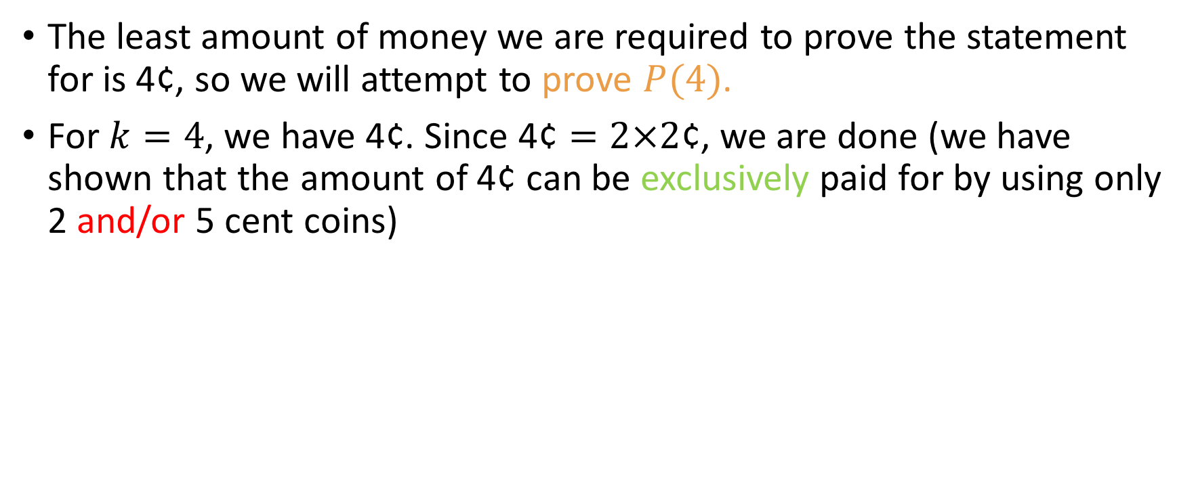
Inductive base
The least amount of money we are required to prove the statement for is 4¢, so we will attempt to prove $P(4)$.
For $k=4$, we have 4¢. Since $\text{4¢}=2×2\text{¢}$, we are done (we have shown that the amount of 4¢ can be exclusively paid for by using only 2 and/or 5 cent coins)

Slide 54
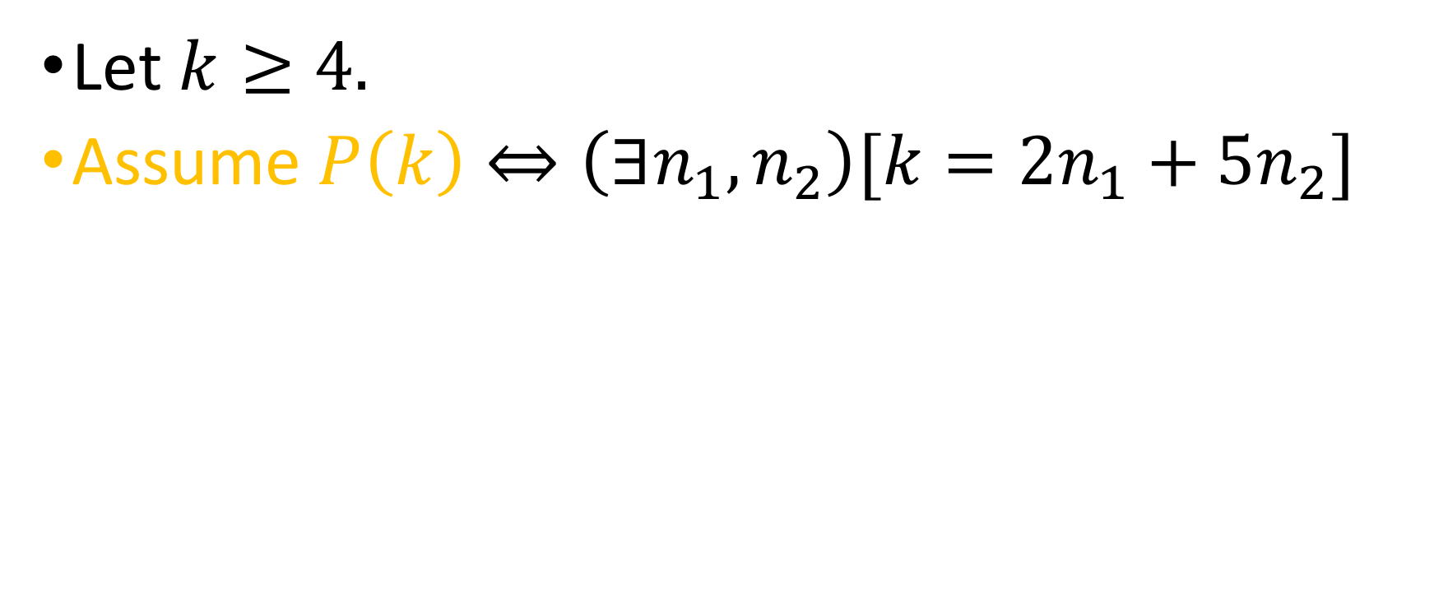
Inductive hypothesis
Let $k≥4.$
Assume $P\left(k\right)⇔\left(∃n_{1},n_{2}\right)[k=2n_{1}+5n_{2}]$

Slide 55
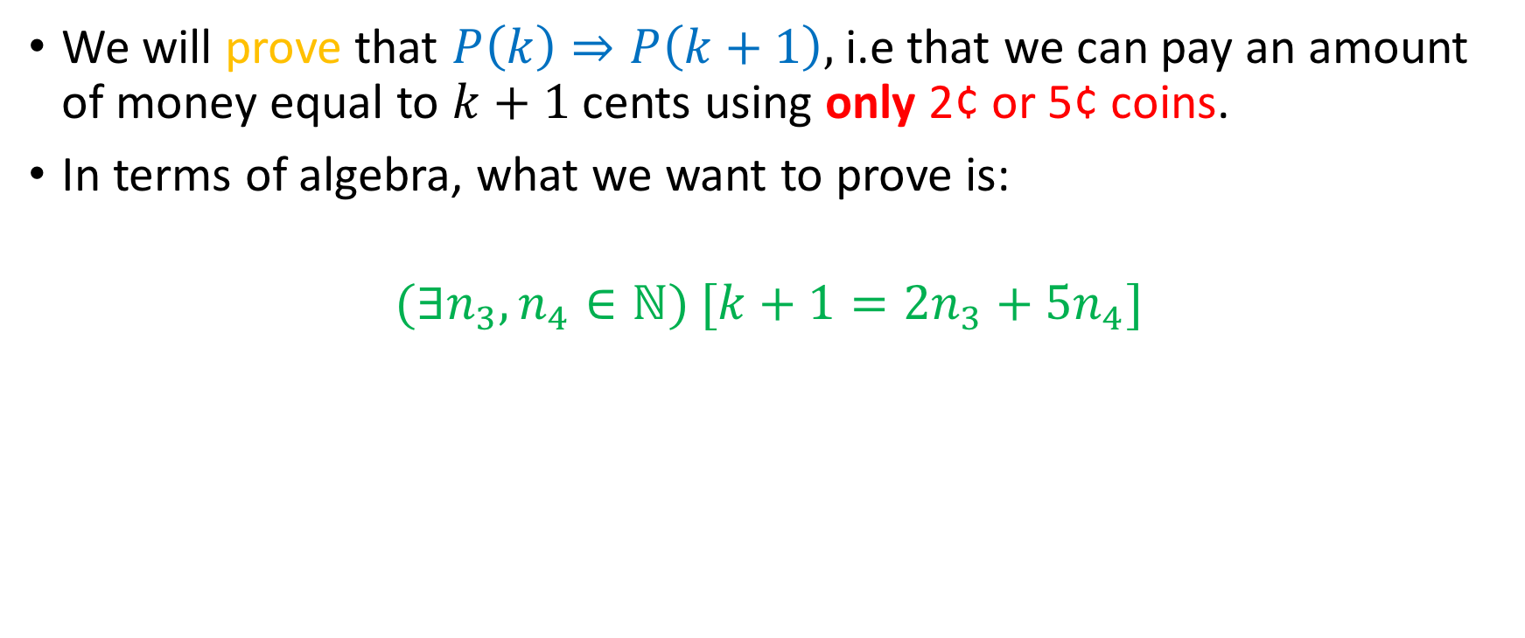
Inductive step
We will prove that $P\left(k\right)⇒P\left(k+1\right),$ i.e that we can pay an amount of money equal to $k+1$ cents using only 2¢ or 5¢ coins.
In terms of algebra, what we want to prove is:
$$(∃n_{3},n_{4}∈{ℕ)}^{ }[k+1=2n_{3}+5n_{4}]$$

Slide 56
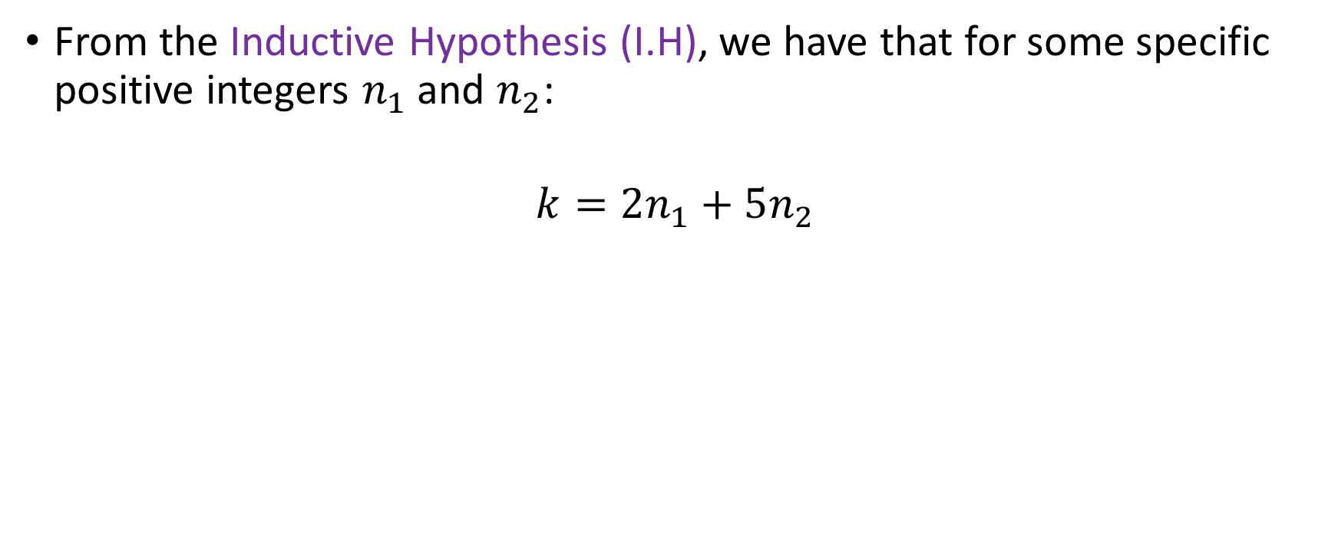
Inductive Step (contd.)
From the Inductive Hypothesis (I.H), we have that for some specific positive integers $n_{1}$ and $n_{2}$:
$$k=2n_{1}+5n_{2}$$

Slide 57
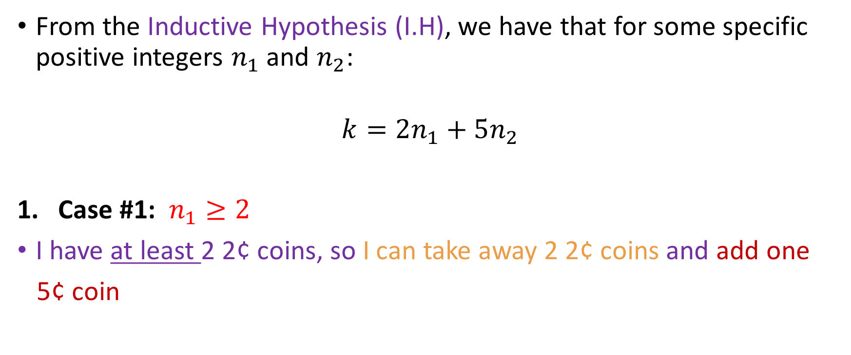
Inductive Step (contd.)
From the Inductive Hypothesis (I.H), we have that for some specific positive integers $n_{1}$ and $n_{2}$:
$$k=2n_{1}+5n_{2}$$
Case #1: $n_{1}≥2$
I have at least 2 2¢ coins, so I can take away 2 2¢ coins and add one
5¢ coin

Slide 58
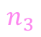
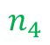
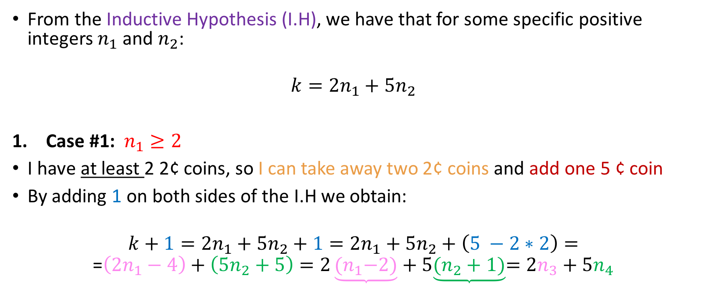
Inductive Step (contd.)
From the Inductive Hypothesis (I.H), we have that for some specific positive integers $n_{1}$ and $n_{2}$:
$$k=2n_{1}+5n_{2}$$
Case #1: $n_{1}≥2$
I have at least 2 2¢ coins, so I can take away two 2¢ coins and add one 5 ¢ coin
By adding 1 on both sides of the I.H we obtain:
$$k+1=2n_{1}+5n_{2}+1=2n_{1}+5n_{2}+\left(5 −2∗2\right)=$$
$$\text{=}\left(2n_{1}−4\right)+\left(5n_{2}+5\right)=2\underbrace{{(n}_{1}−2)}+5\underbrace{(n_{2}+1)}=2n_{3}+5n_{4}$$
$$n_{3}$$
$$n_{4}$$

Slide 59


Inductive Step (contd.)
From the Inductive Hypothesis (I.H), we have that for some specific positive integers $n_{1}$ and $n_{2}$:
$$k=2n_{1}+5n_{2}$$
Case #1: $n_{1}≥2$
I have at least 2 2¢ coins, so I can take away two 2¢ coins and add one 5 ¢ coin
By adding 1 on both sides of the I.H we obtain:
$$k+1=2n_{1}+5n_{2}+1=2n_{1}+5n_{2}+\left(5 −2∗2\right)=$$
$$\text{=}\left(2n_{1}−4\right)+\left(5n_{2}+5\right)=2\underbrace{{(n}_{1}−2)}+5\left(n_{2}+1\right)=2n_{3}+5n_{4}$$
$n_{1}−2≥0$ because $$n_{1}≥2$$

Slide 60



Inductive step
Case #2: $n_{2}≥1$
I have at least one 5¢ coin so I can take away one 5¢ coin and add three 2¢ coins
By adding 1 on both sides of the I.H we obtain:
$$k+1=2n_{1}+5n_{2}+1=2n_{1}+5n_{2}+\left(3∗2−5\right)=$$
$=2\underbrace{{(n}_{1}+3)} +5\underbrace{(n_{2}−1)}=2n_{3}+5n_{4}$
$$n_{3}$$
$$n_{4}$$

Slide 61


Inductive step
Case #2: $n_{2}≥1$
I have at least one 5¢ coin so I can take away one 5¢ coin and add three 2¢ coins
By adding 1 on both sides of the I.H we obtain:
$$k+1=2n_{1}+5n_{2}+1=2n_{1}+5n_{2}+\left(3∗2−5\right)=$$
$=2(n_{1}+3) +5\underbrace{(n_{2}−1)}=2n_{3}+5n_{4}$
$$n_{2}−1≥0$$
because
$$n_{2}≥1$$

Slide 62

Inductive step
Case #3: ${(n}_{1}≤1)∧(n_{2}=0)$
This case means that we have either 0 or 2¢ at our disposal.
But this is not possible, since we want to prove the theorem only for values $≥4\text{¢}$
So we’re done. $□$

Slide 63

A note about the penny problem
Note that we proved the theorem for $n≥4$
Generally speaking, we can use induction to prove statements $P\left(n\right) ∀n≥n_{0}$, where $n_{0}∈ℕ$.
Most of the time $n_{0}$ will be small (0, 1, 2, …)

Slide 64








A note about the penny problem
Note that we proved the theorem for $n≥4$
Generally speaking, we can use induction to prove statements $P\left(n\right) ∀n≥n_{0}$, where $n_{0}∈ℕ$.
Most of the time $n_{0}$ will be small (0, 1, 2, …)
$$P(n)$$
$$0$$
$$1$$
$$2$$
$$…$$
$$n_{0}$$
$$n_{0}+1$$
$$n_{0}+2$$
$$…$$
$$…$$
$$…$$
$$…$$
$$…$$
$$…$$
$$…$$

Slide 65



A note about the penny problem
Note that we proved the theorem for $n≥4$
Generally speaking, we can use induction to prove statements $P\left(n\right) ∀n≥n_{0}$, where $n_{0}∈ℕ$.
Most of the time $n_{0}$ will be small (0, 1, 2, …)
$P\left(n_{0}\right)∧(∀k≥n_{0})[P\left(k\right)⇒P(k+1)]$
$$0$$
$$1$$
$$2$$
$$…$$
$$n_{0}$$
$$n_{0}+1$$
$$n_{0}+2$$
$$…$$
$$…$$
$$k$$
$$⇒$$
$$k+1$$
$$…$$
$$…$$
$$…$$

Slide 66

Here’s one with an inequality!
Prove that for all integers $n$ at least $4$, $2^{n}<n!$
I.B: We will prove $P\left(4\right)⇔2^{4}<4!$ Done.
I.H: For $k≥4$, we assume $P\left(k\right),$ i.e $2^{k}<k!$
I.S: We will prove $P\left(k\right)⇒P(k+1)$, i.e
$${(2}^{k}<k!)⇒{(2}^{k+1}<\left(k+1\right)!)$$

Slide 67

Inductive Step…
Prove that for all integers $n$ at least $4$, $2^{n}<n!$
I.B: We will prove $P\left(4\right): 2^{4}<4!$ Done.
I.H: For $k≥4$, we assume $P\left(k\right): 2^{k}<k!$
I.S: We will prove${ (2}^{k}<k!)⇒{(2}^{k+1}<\left(k+1\right)!)$

Slide 68

Inductive Step…
Prove that for all integers $n$ at least $4$, $2^{n}<n!$
I.B: We will prove $P\left(4\right): 2^{4}<4!$ Done.
I.H: For $k≥4$, we assume $P\left(k\right): 2^{k}<k!$
I.S: We will prove${ (2}^{k}<k!)⇒{(2}^{k+1}<\left(k+1\right)!)$
From algebra, we have that $2^{k+1}=2^{k}⋅2 \text{(1)}$

Slide 69

Inductive Step…
Prove that for all integers $n$ at least $4$, $2^{n}<n!$
I.B: We will prove $P\left(4\right): 2^{4}<4!$ Done.
I.H: For $k≥4$, we assume $P\left(k\right): 2^{k}<k!$
I.S: We will prove${ (2}^{k}<k!)⇒{(2}^{k+1}<\left(k+1\right)!)$
From algebra, we have that $2^{k+1}=2^{k}⋅2 \text{(1)}$
From the I.H, we have that $2^{k}<k!\underset{⇔}{2>0}2^{k}⋅2<k!⋅2$ (2)

Slide 70

Inductive Step…
Prove that for all integers $n$ at least $4$, $2^{n}<n!$
I.B: We will prove $P\left(4\right): 2^{4}<4!$ Done.
I.H: For $k≥4$, we assume $P\left(k\right): 2^{k}<k!$
I.S: We will prove${ (2}^{k}<k!)⇒{(2}^{k+1}<\left(k+1\right)!)$
From algebra, we have that $2^{k+1}=2^{k}⋅2 \text{(1)}$
From the I.H, we have that $2^{k}<k!\underset{⇔}{2>0}2^{k}⋅2<k!⋅2$ (2)
Since $k≥4$, we have that $2<k+1\underset{⇔}{k! > 0}k!⋅2<k!\left(k+1\right) (3)$

Slide 71

Inductive Step…
Prove that for all integers $n$ at least $4$, $2^{n}<n!$
I.B: We will prove $P\left(4\right): 2^{4}<4!$ Done.
I.H: For $k≥4$, we assume $P\left(k\right): 2^{k}<k!$
I.S: We will prove${ (2}^{k}<k!)⇒{(2}^{k+1}<\left(k+1\right)!)$
From algebra, we have that $2^{k+1}=2^{k}⋅2 \text{(1)}$
From the I.H, we have that $2^{k}<k!\underset{⇔}{2>0}2^{k}⋅2<k!⋅2$ (2)
Since $k≥4$, we have that $2<k+1\underset{⇔}{k! > 0}k!⋅2<k!\left(k+1\right) (3)$
$\left(2\right)\underset{⇒}{(3)} 2^{k}⋅2<\left(k+1\right)!\underset{⇔}{\left(1\right)}2^{k+1}<\left(k+1\right)!$

Slide 72

Inductive Step…
Prove that for all integers $n$ at least $4$, $2^{n}<n!$
I.B: We will prove $P\left(4\right): 2^{4}<4!$ Done.
I.H: For $k≥4$, we assume $P\left(k\right): 2^{k}<k!$
I.S: We will prove${ (2}^{k}<k!)⇒{(2}^{k+1}<\left(k+1\right)!)$
From algebra, we have that $2^{k+1}=2^{k}⋅2 \text{(1)}$
From the I.H, we have that $2^{k}<k!\underset{⇔}{2>0}2^{k}⋅2<k!⋅2$ (2)
Since $k≥4$, we have that $2<k+1\underset{⇔}{k! > 0}k!⋅2<k!\left(k+1\right) (3)$
$\left(2\right)\underset{⇒}{(3)} 2^{k}⋅2<\left(k+1\right)!\underset{⇔}{\left(1\right)}2^{k+1}<\left(k+1\right)!$

Slide 73


Inductive Step…
Prove that for all integers $n$ at least $4$, $2^{n}<n!$
I.B: We will prove $P\left(4\right): 2^{4}<4!$ Done.
I.H: For $k≥4$, we assume $P\left(k\right): 2^{k}<k!$
I.S: We will prove${ (2}^{k}<k!)⇒{(2}^{k+1}<\left(k+1\right)!)$
From algebra, we have that $2^{k+1}=2^{k}⋅2 \text{(1)}$
From the I.H, we have that $2^{k}<k!\underset{⇔}{2>0}2^{k}⋅2<k!⋅2$ (2)
Since $k≥4$, we have that $2<k+1\underset{⇔}{k! > 0}k!⋅2<k!\left(k+1\right) (3)$
$\left(2\right)\underset{⇒}{(3)} 2^{k}⋅2<\left(k+1\right)!\underset{⇔}{\left(1\right)}2^{k+1}<\left(k+1\right)!$
Compressed Ind. Step
$$2^{k+1}=2⋅2^{k}<2⋅k!$$
$$<\left(k+1\right)⋅k!=$$
$$\left(k+1\right)!$$
$$⇔P\left(k+1\right)$$

Slide 74

And one with more than 1 variable!
Prove that the sum of the first $n$ terms of a geometric sequence with $m∈(ℝ−\left\{1\right\})$ and $a_{0}=1$ is equal to $\frac{m^{n} −1}{m −1}.$
Symbolically:
$$\sum_{i=0}^{n−1}{m^{i}=}\frac{m^{n} −1}{m −1}$$

Slide 75

And one with more than 1 variable!
Prove that the sum of the first $n$terms of a geometric sequence with
$m∈(ℝ−\left\{1\right\})$and $a_{0}=1$ is equal to $\frac{m^{n} −1}{m −1}.$
Symbolically:
$$\sum_{i=0}^{n−1}{m^{i}=}\frac{m^{n} −1}{m −1}$$
In this instance, we have two variables, $m$ and $n$, and it’s spectacularly easy to confuse ourselves (and the reader) about which variable we will be focusing on.
So, we will explicitly say, at the beginning of our proof, that we will be performing a proof by induction on $n$.

Slide 76

Proof
Proof : We attempt to prove $P\left(n\right), ∀n∈ℕ^{ }$. We proceed via induction on $n.$
Inductive base: We attempt to prove $P\left(0\right).$
$P\left(0\right):$ $\sum_{i=0}^{0−1}{m^{i}=}\frac{m^{0} −1}{m −1}⇔\sum_{i=0}^{−1}{m^{i}=}\frac{m^{0} −1}{m −1}⇔0=0$
So $P(0)$ is true.
Inductive hypothesis: We assume $P(k)$ for some $k≥0$, i.e
$$\sum_{i=0}^{k−1}{m^{i}=\frac{m^{k} −1}{m −1}}$$

Slide 77

Proof (contd.)
Inductive step: We will attempt to prove $P\left(k+1\right),$ i.e
$$\sum_{i=0}^{k}{m^{i}=\frac{m^{k+1} −1}{m −1}}$$
From the LHS to the RHS:
$$LHS= \sum_{i=0}^{k}{m^{i}=\sum_{i=0}^{k−1}{m^{i}+m^{k}=\frac{m^{k}−1 }{m−1}+m^{k}=\frac{m−1 +r^{k}(r−1) }{r−1}=}}\frac{r^{k+1}−1}{r−1}\text{=} \text{RHS} □$$
By the I.H

Slide 78

Hey, wait a minute!
In the sequences lecture, YOU said that geometric progression with $m=1$ were fine.
However, we just proved that
$$\sum_{i=0}^{n−1}{m^{i}=}\frac{m^{n} −1}{m −1}$$
So, what is the summation in the case of $m=1?$
Easy:
$\sum_{i=0}^{n−1}{1^{i}=}$ $\sum_{i=0}^{n−1}{1=n}$

Slide 79

Complete theorem
For $m∈ℝ:$
$$\sum_{i=0}^{n−1}{m^{i}=}\left\{\begin{aligned}\frac{m^{n}−1}{m−1}, m≠1 \\ \\ n ,m=1\end{aligned}\right.$$

Slide 80

And here’s four for you!
$\left(∀n∈ℕ\right)[ \sum_{i=0}^{n}{2^{i}=2^{n+1} −1 ]}$
$\left(∀n≥2\right)[\sum_{i=1}^{n−1}{i\left(i+1\right)= \frac{n\left(n−1\right)\left(n+1\right)}{3}]}$
$\left(∀n∈ℕ\right)[\prod_{i=0}^{n}{\left(\frac{1}{\left(2i+1\right)⋅\left(2i+2\right)}\right)}= \frac{1}{\left(2n+2\right)!}]$
$\left(∀n∈ℕ\right)[ 3 | 2^{2n}−1]$

